Slide 1
CSD 310 Group 5
Brandon Hackett
Darnell Lewis
Derek Livermont
Lindsey Yin

Slide 2


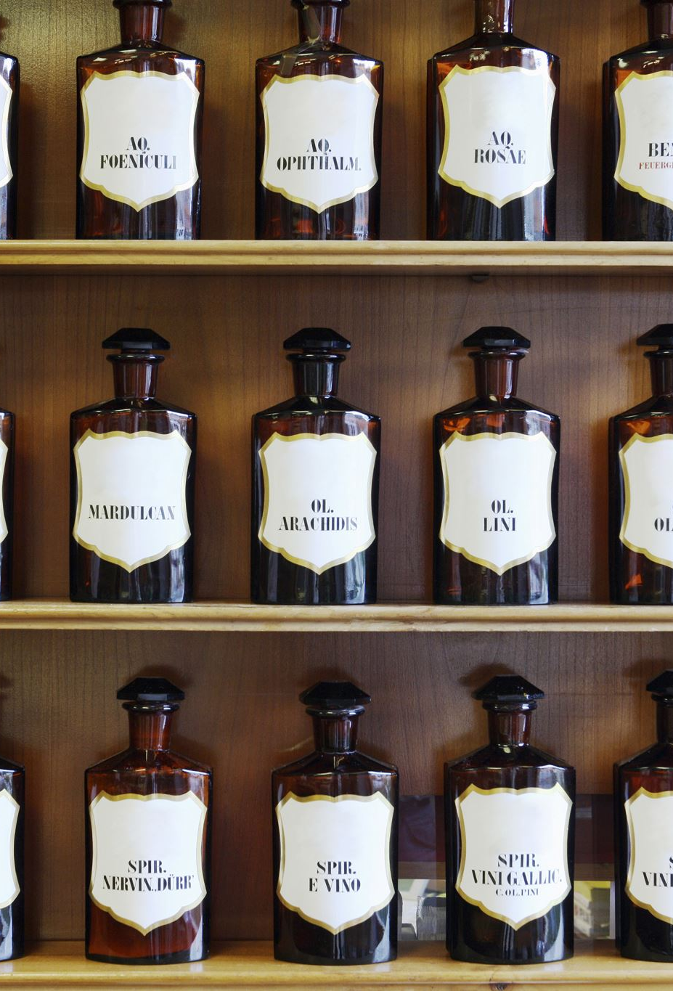
Bacchus Case Study
Stan and Davis Bacchus, brothers and co-owners of Bacchus Winery, inherited the family winery from their father, George. Eager to modernize the business and enhance product quality and customer service, they retained the existing personnel, including Janet Collins (Finance and Payroll), Roz Murphy (Marketing), Bob Ulrich (Marketing Assistant), Henry Doyle (Production Manager), and Maria Costanza (Distribution).
The winery produces Merlot, Cabernet, Chablis, and Chardonnay wines, cultivating their own grapes. Facing challenges in supply management, Stan and Davis seek efficient methods for tracking and ordering supplies, contemplating internet-based solutions. Maria, responsible for distribution, envisions online ordering and shipment tracking for distributors.
As the yearly business snapshot approaches, the owners require insights into supplier reliability, wine distribution performance, and employee working hours. Key questions include the timeliness of supplier deliveries, wine sales analysis, and employee work hours over the past four quarters.
The case study emphasizes the need for a comprehensive database system to streamline operations, monitor supply chains, enhance distributor interactions, and assess employee productivity. It sets the stage for implementing technology solutions to propel Bacchus Winery into a new era of efficiency and success.

Slide 3
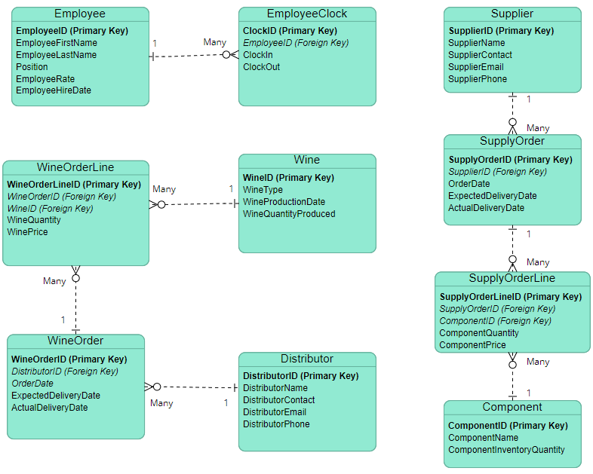

Entity Relationship Diagram
Based on the needs stated by Stan and Davis, the database can be broken down into three main areas: employees, suppliers, and wines.
On the employee side, we maintain an employee and a clock-in table that can be queried to form time sheets and pull labor costs.
The supplier tables allow tracking of supply orders as well as components on-hand.
Finally, the wine tables track wines from production through the shipment process to our distributors.

Slide 4
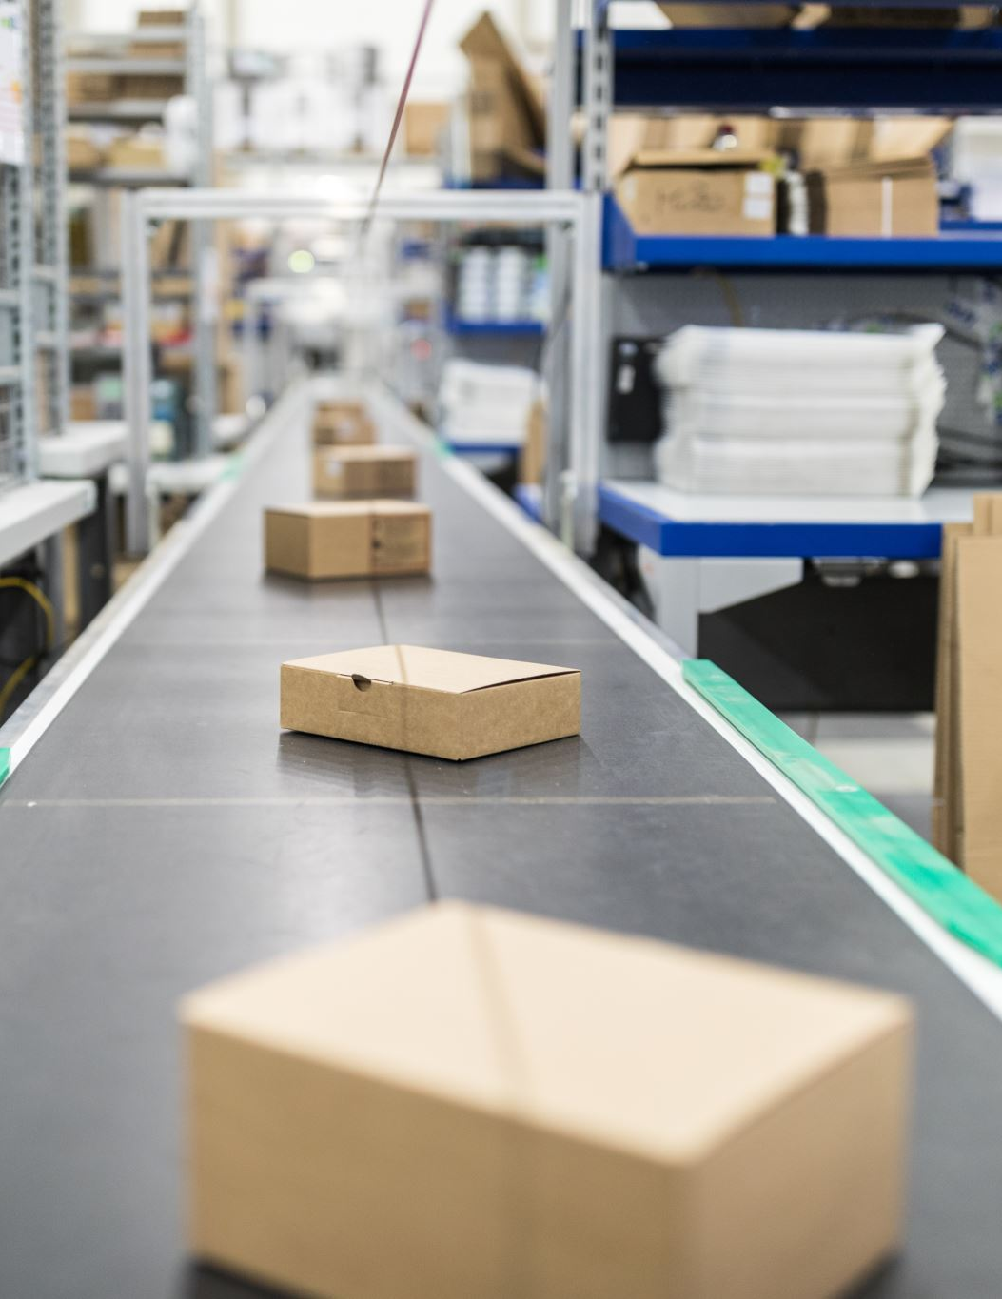
ERD Continued
Using this database design, we intended to address the employee's time or yearly snapshot, wine deliveries, and supply deliveries.
We purposely made our ERD more granular to track line items in wine orders and supplies. This also follows good database design.

Slide 5

Business Reports
Based on the case study, we put together reports that would be meaningful to Bacchus Winery. These include:
Total Sales By Wines
Late Orders
Wine Type by Distributor
Employee Time Report

Slide 6
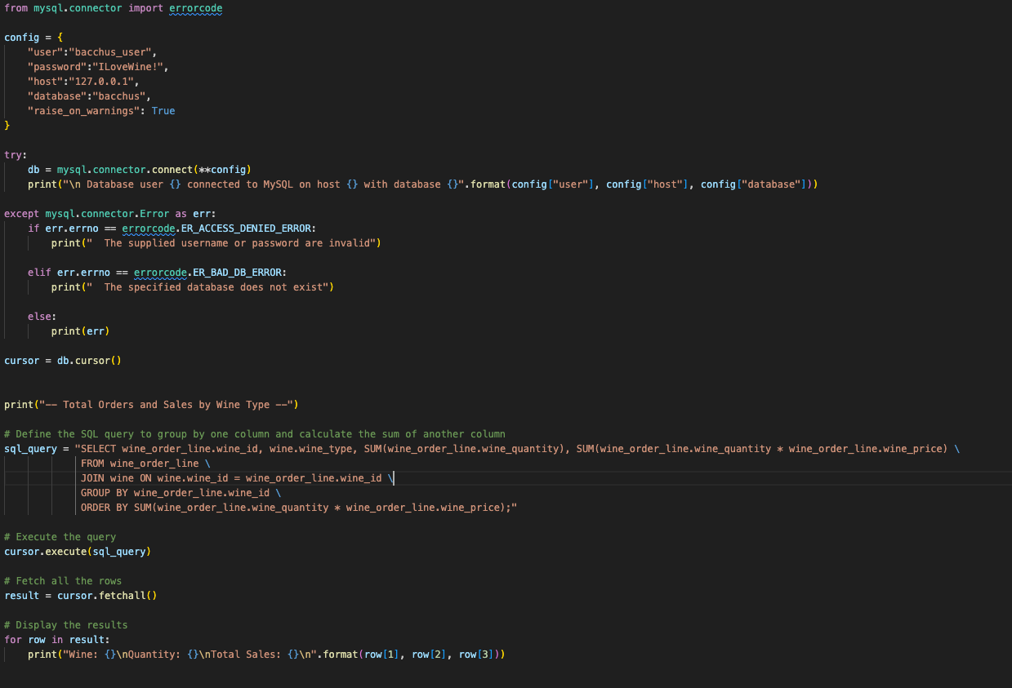
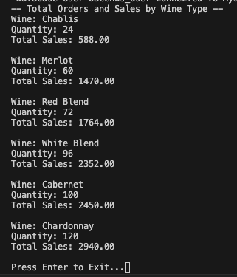
Total Sales by Wine Report
This Python script generates a report that provides information on total wine sales by type. It achieves this by retrieving data from the `wine_order_line` and `wine` tables through SQL joins. The report displays the Each type of wine, quantity sold and the calculated sales for that wine. The report is sorted by lowest sales to highest. This report can be used by the owners to understand which wines are preforming the lowest and which wines are selling well.

Slide 7
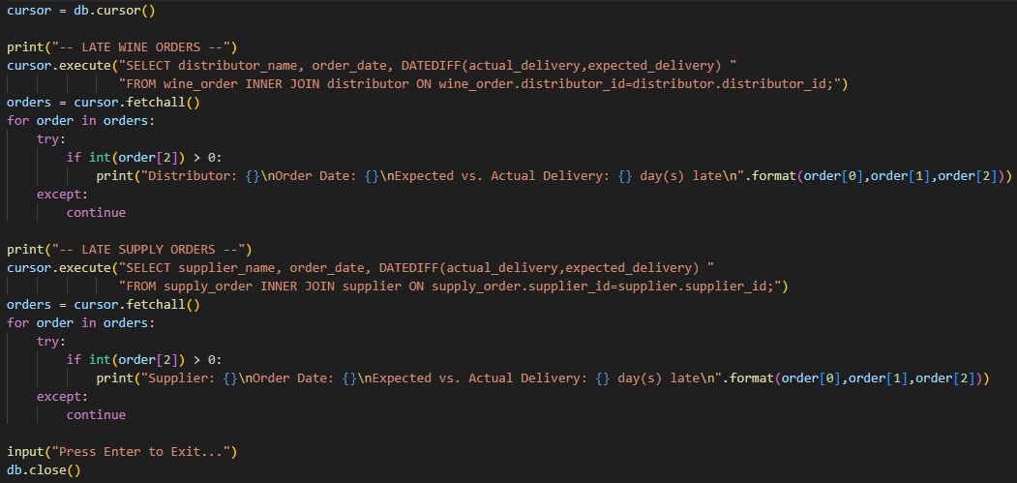
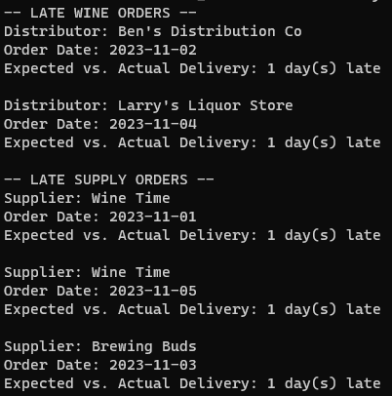
Late Orders Report
This report pulls up every delivery where the actual delivery happened after the expected delivery. This pulls up every delivery within the sample data but could be easily adjusted into a front end where managers can enter specific periods that would be fed into a WHERE statement to narrow down results.

Slide 8
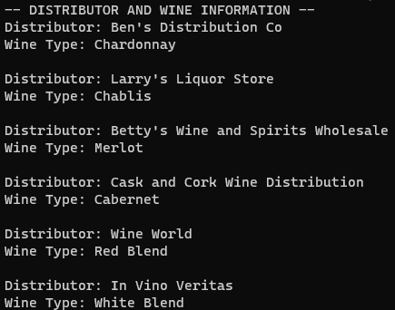
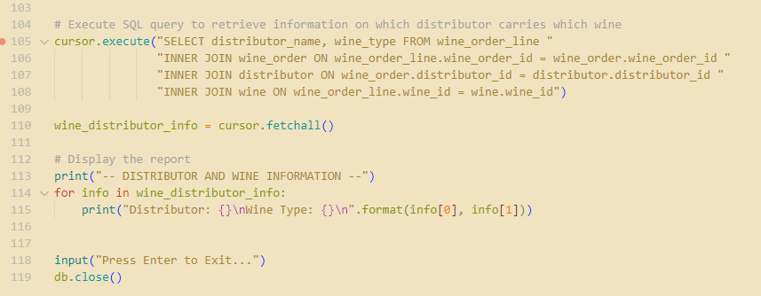
Wine Types by Distributor Report
This Python script generates a report that provides information on which distributor carries which wine. It achieves this by retrieving data from the `wine_order_line`, `wine_order`, `distributor`, and `wine` tables through SQL joins. The report displays the distributor name along with the corresponding wine types they carry. This information is crucial for business decisions, as it allows the winery owners to understand the distribution network and popularity of different wines among distributors.

Slide 9
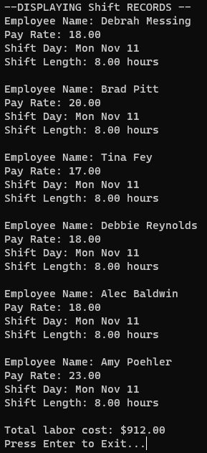
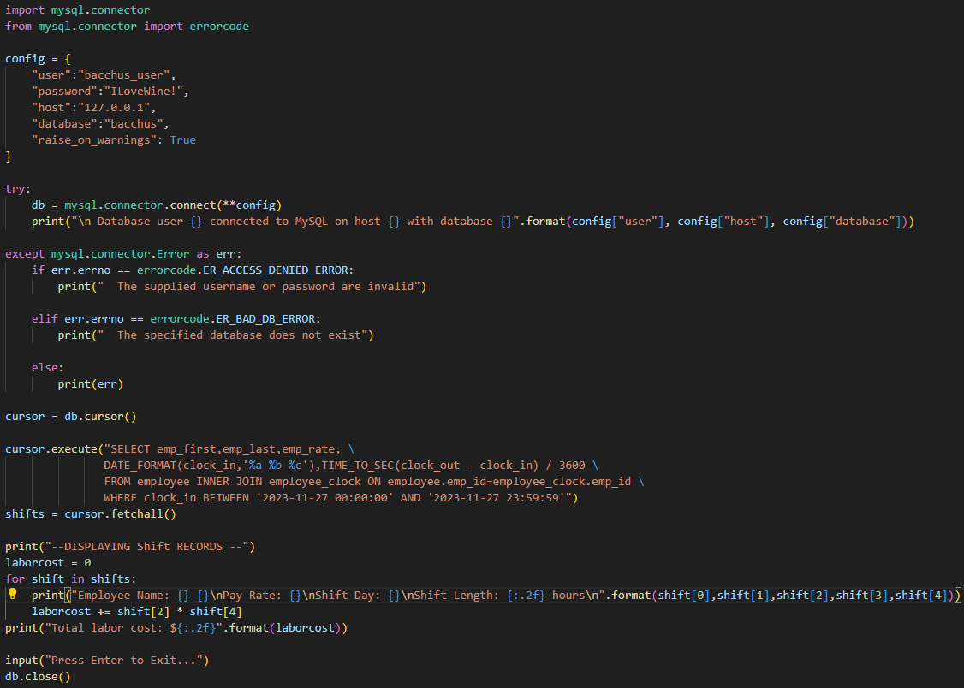
Employee Time Report
This report will draw up all shift records for a range of time periods. Although this is just one iteration of the script, it shows the flexibility of our database design. For example, as it’s written, this script pulls up all the shift records for the one day of sample data we have. However, the BETWEEN statement could be attached to a front-end where a custom time-period could be pulled up. Additionally, a HAVING statement could be added to isolate a single employee for a payroll report.

Slide 10
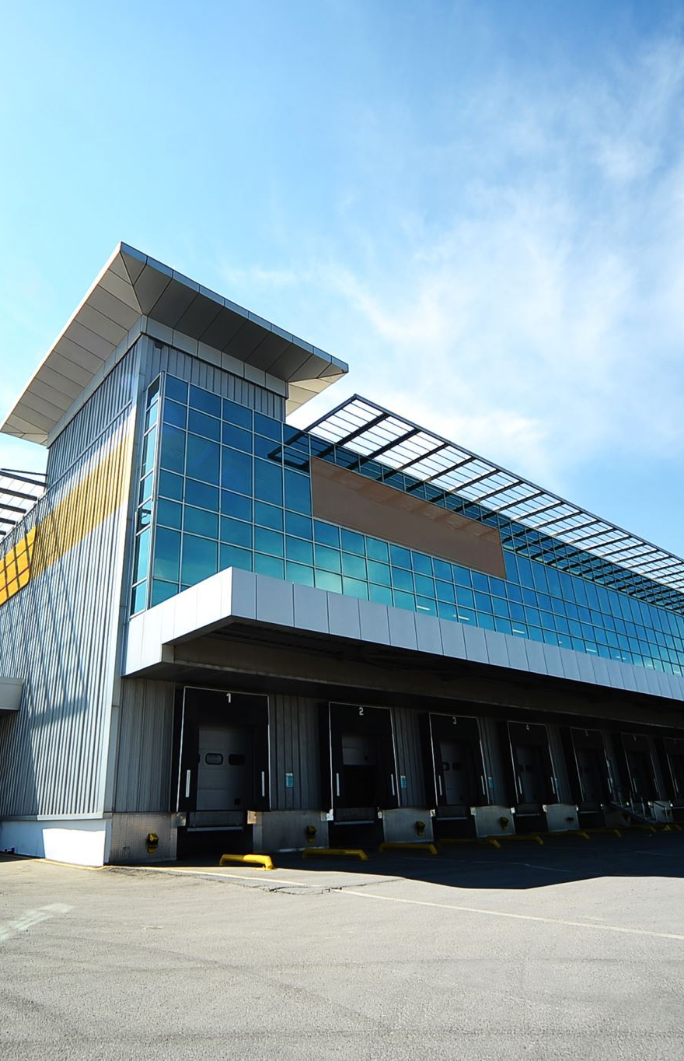
Assumptions
We structured our ERD in a way that line items being cancelled wouldn't impact the database.
An expected delivery schedule is communicated to vendors and buyers to establish an on-time delivery threshold.
An online system will streamline the tracking and ordering process, providing real-time updates on inventory levels and facilitating efficient ordering.
Implementing an online ordering system for distributors will enhance communication and streamline the distribution process.
Accurate timekeeping systems are in place, and employee work hours directly contribute to payroll, production, and overall business operations.

